Slide 1
GUI building with Swing

Slide 2
How to build a GUI
Create a window in which to display things—usually a JFrame (for an application), or a JApplet
Use the setLayout(LayoutManager manager) method to specify a layout manager
Create some Components, such as buttons, panels, etc.
Add your components to your display area, according to your chosen layout manager
Write some Listeners and attach them to your Components
  Interacting with a Component causes an Event to occur
  A Listener gets a message when an interesting event occurs, and executes some code to deal with it
Display your window

Slide 3
Import the necessary packages
The Swing components are in javax.swing.*, so you always need to import that for a Swing application
Swing is built on top of AWT and uses a number of AWT packages, including most of the layout managers, so you need to import java.awt.*
Most listeners also come from the AWT, so you also need to import java.awt.event.*
A few listeners, such as DocumentListener and ListSelectionListener, are specific to Swing, so you may need to import javax.swing event.*
For more complex GUIs, there are additional java.awt.something and javax.swing.something packages that you may need to import

Slide 4
Make a Container
For an application, your container is typically a JFrame
  JFrame frame = new JFrame();
  JFrame frame = new JFrame("Text to put in title bar");
You can create a JFrame in your “main class”
It’s often more convenient to have your “main class” extend JFrame
For an applet, your “main class” must extend JApplet
Once your application or applet is up and running, it create and display various dialogs

Slide 5
Add a layout manager
The most important layout managers are:
  BorderLayout
    Provides five areas into which you can put components
    This is the default layout manager for both JFrame and JApplet
  FlowLayout
    Components are added left to right, top to bottom
  GridLayout
    Components are put in a rectangular grid
    All areas are the same size and shape
  BoxLayout
    Creates a horizontal row or a vertical stack
    This can be a little weird to use
  GridBagLayout
    Too complex and a danger to your sanity--avoid

Slide 6
Add components to containers
The usual command is
container.add(component);
  For FlowLayout, GridLayout, and BoxLayout, this adds the component to the next available location
  For BorderLayout, this puts the component in the CENTER by default
For BorderLayout, it’s usually better to use
container.add(component, BorderLayout.position);
  position is one of NORTH, SOUTH, EAST, WEST, or CENTER

Slide 7
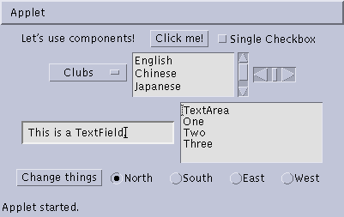
Some types of components
JButton
JCheckbox
JLabel
JChoice
JScrollbar
JTextField
JList
JTextArea
JButton
JCheckbox
JCheckboxGroup

Slide 8
Create components
JButton button = new JButton("Click me!");
JLabel label = new JLabel("This is a JLabel");
JTextField textField1 = new JTextField("This is the initial text");
JTextField textField2 = new JTextField("Initial text", columns);
JTextArea textArea1 = new JTextArea("Initial text");
JTextArea textArea2 = new JTextArea(rows, columns);
JTextArea textArea3 = new JTextArea("Initial text", rows, columns);
JCheckBox checkbox = new JCheckBox("Label for checkbox");
JRadioButton radioButton1 = new JRadioButton("Label for button");
ButtonGroup group = new ButtonGroup();
group.add(radioButton1); group.add(radioButton2); etc.
This is just a sampling of the available constructors; see the javax.swing API for all the rest

Slide 9
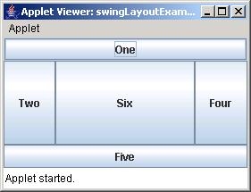
BorderLayout
public class BorderLayoutExample extends JApplet {
public void init () {
setLayout(new BorderLayout ());
add(new JButton("One"), BorderLayout.NORTH);
add(new JButton("Two"), BorderLayout.WEST);
add(new JButton("Three"), BorderLayout.CENTER);
add(new JButton("Four"), BorderLayout.EAST);
add(new JButton("Five"), BorderLayout.SOUTH);
add(new JButton("Six"));
}
}

Slide 10
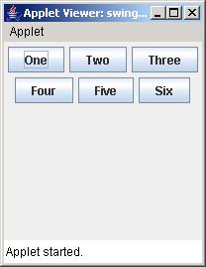
FlowLayout
public class FlowLayoutExample extends JApplet {
public void init () {
setLayout(new FlowLayout ());
add(new JButton("One"));
add(new JButton("Two"));
add(new JButton("Three"));
add(new JButton("Four"));
add(new JButton("Five"));
add(new JButton("Six"));
}
}

Slide 11
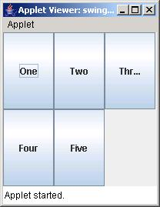
GridLayout
public class GridLayoutExample extends JApplet {
public void init() {
setLayout(new GridLayout(2, 4));
add(new JButton("One"));
add(new JButton("Two"));
add(new JButton("Three"));
add(new JButton("Four"));
add(new JButton("Five"));
}
}

Slide 12
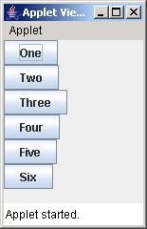
BoxLayout
public class BoxLayoutExample extends JApplet {
public void init () {
Box box = new Box(BoxLayout.Y_AXIS);
add(box);
box.add(new JButton("One"));
box.add(new JButton("Two"));
box.add(new JButton("Three"));
box.add(new JButton("Four"));
box.add(new JButton("Five"));
box.add(new JButton("Six"));
}
}

Slide 13
Nested layouts
A JPanel is both a JContainer and a Component
  Because it’s a container, you can put other components into it
  Because it’s a component, you can put it into other containers
All but the very simplest GUIs are built by creating several JPanels, arranging them, and putting components (possibly other JPanels) into them
A good approach is to draw (on paper) the arrangement you want, then finding an arrangement of JPanels and their layout managers that accomplishes this

Slide 14
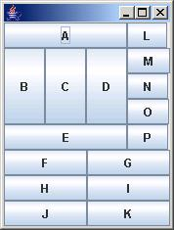
An example nested layout
Container container = new JFrame() or JApplet();
JPanel p1 = new JPanel();
p1.setLayout(new BorderLayout());
p1.add(new JButton("A"), BorderLayout.NORTH);
// also add buttons B, C, D, E
JPanel p2 = new JPanel();
p2.setLayout(new GridLayout(3, 2));
p2.add(new JButton("F"));
// also add buttons G, H, I, J, K
JPanel p3 = new JPanel();
p3.setLayout(new BoxLayout(p3, BoxLayout.Y_AXIS));
p3.add(new JButton("L"));
// also add buttons M, N, O, P
container.setLayout(new BorderLayout());
container.add(p1, BorderLayout.CENTER);
container.add(p2, BorderLayout.SOUTH);
container.add(p3, BorderLayout.EAST);

Slide 15
Create and attach listeners
JButton okButton = new JButton("OK");
okButton.addActionListener(new MyOkListener());
class MyOkListener implements ActionListener {
public void actionPerformed(ActionEvent event) {
// code to handle okButton click
}
}
A small class like this is often best implemented as an anonymous inner class

Slide 16
Using an anonymous inner class
Instead of:
  okButton.addActionListener(new MyOkListener());
  class MyOkListener implements ActionListener {
  public void actionPerformed(ActionEvent event) {
  // code to handle OK button click
  }
  }
You can do this:
  okButton.addActionListener(new ActionListener() {
  public void actionPerformed(ActionEvent event) {
  // code to handle OK button click
  }
  );
Keep anonymous inner classes very short (typically just a call to one of your methods), as they can really clutter up the code

Slide 17
Suggested program arrangement 1
class SomeClass {
// Declare components as instance variables
JFrame frame; // Can also define them here if you prefer
JButton button;
public static void main(String[] args) {
new SomeClass().createGui();
}
// Define components and attach listeners in a method
void createGui() {
frame = new JFrame();
button = new JButton("OK");
frame.add(button); // (uses default BorderLayout)
button.addActionListener(new MyOkListener());
}
// Use an inner class as your listener
class MyOkButtonListener implements ActionListener {
public void actionPerformed(ActionEvent event) {
// Code to handle button click goes here
}
}
}

Slide 18
Suggested program arrangement 2
class SomeClass extends JFrame {
// Declare components as instance variables
// JFrame frame; // Don't need this
JButton button;
public static void main(String[] args) {
new SomeClass().createGui();
}
// Define components and attach listeners in a method
void createGui() {
// frame = new JFrame(); // Don't need this
button = new JButton("OK");
add(button); // Was: frame.add(button);
button.addActionListener(new MyOkListener());
}
// Use an inner class as your listener
class MyOkButtonListener implements ActionListener {
public void actionPerformed(ActionEvent event) {
// Code to handle button click goes here
}
}
}

Slide 19
Components use various listeners
JButton, JMenuItem, JComboBox, JTextField:
  addActionListener(ActionListener)
    public void actionPerformed(ActionEvent event)
JCheckBox, JRadioButton:
  addItemListener(ItemListener)
    public void itemStateChanged(ItemEvent event)
JSlider
  addChangeListener(ChangeListener)
    public void stateChanged(ChangeEvent event)
JTextArea
  getDocument().addDocumentListener(DocumentListener)
    public void insertUpdate(DocumentEvent event)
    public void removeUpdate(DocumentEvent event)
    public void changedUpdate(DocumentEvent event)

Slide 20
Getting values
Some user actions normally cause the program to do something: clicking a button, or selecting from a menu
Some user actions set values to be used later: entering text, setting a checkbox or a radio button
  You can listen for events from these, but it’s not usually a good idea
  Instead, read their values when you need them
    String myText = myJTextField.getText();
    String myText = myJTextArea.getText();
    boolean checked = myJCheckBox.isSelected();
    boolean selected1 = myJRadioButton1.isSelected();

Slide 21
Enabling and disabling components
It is poor style to remove components you don’t want the user to be able to use
  “Where did it go? It was here a minute ago!”
It’s better to enable and disable controls
  Disabled controls appear “grayed out”
  The user may still wonder why?, but that’s still less confusing
anyComponent.setEnabled(enabled);
  Parameter should be true to enable, false to disable

Slide 22
Dialogs
A dialog (small accessory window) can be modal or nonmodal
  When your code opens a modal dialog, it waits for a result from the dialog before continuing
  When your code opens a nonmodal dialog, it does so in a separate thread, and your code just keeps going
Sun supplies a few simple (but useful) modal dialogs for your use
You can create your own dialogs (with JDialog), but they are nonmodal by default

Slide 23
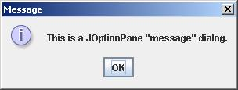
Message dialogs
JOptionPane.showMessageDialog(parentJFrame,
"This is a JOptionPane \"message\" dialog.");
Notice that showMessageDialog is a static method of JOptionPane
The “parentJFrame” is typically your main GUI window (but it’s OK to use null if you don’t have a main GUI window)

Slide 24
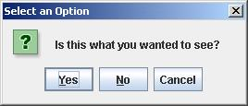
Confirm dialogs
int yesNo =
JOptionPane.showConfirmDialog(parentJFrame,
"Is this what you wanted to see?");
if (yesNo == JOptionPane.YES_OPTION) { ... }

Slide 25
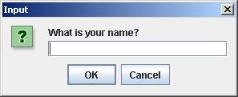
Input dialogs
String userName =
JOptionPane.showInputDialog(parentJFrame,
"What is your name?")

Slide 26
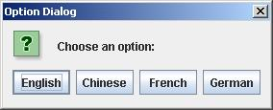
Option dialogs
Object[] options =
new String[] {"English", "Chinese", "French", "German" };
int option =
JOptionPane.showOptionDialog(parentJFrame,
"Choose an option:",
"Option Dialog",
JOptionPane.YES_NO_OPTION,
JOptionPane.QUESTION_MESSAGE,
null,
options,
options[0]); // use as default
Fourth argument could be JOptionPane.YES_NO_CANCEL_OPTION
Fifth argument specifies which icon to use in the dialog; it could be one of ERROR_MESSAGE, INFORMATION_MESSAGE, WARNING_MESSAGE, or PLAIN_MESSAGE
Sixth argument (null above) can specify a custom icon

Slide 27
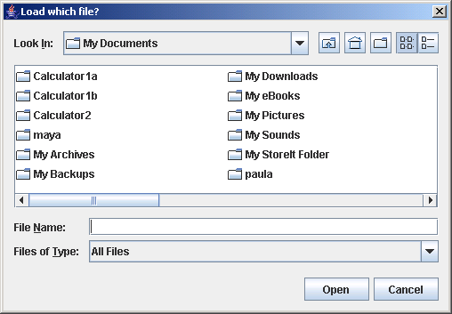
Load file dialogs
JFileChooser chooser = new JFileChooser();
chooser.setDialogTitle("Load which file?");
int result = chooser.showOpenDialog(enclosingJFrame);
if (result == JFileChooser.APPROVE_OPTION) {
File file = chooser.getSelectedFile();
// use file
}
You could also test for CANCEL_OPTION or ERROR_OPTION
You will get back a File object; to use it, you must know how to do file I/O

Slide 28
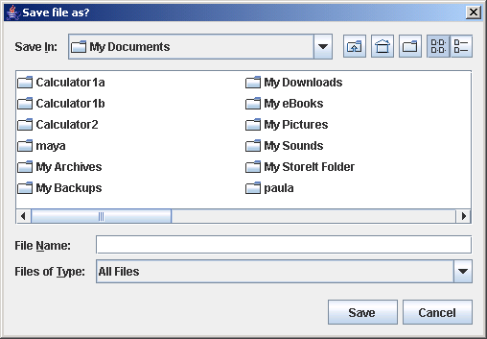
Save file dialogs
JFileChooser chooser = new JFileChooser();
chooser.setDialogTitle(“Save file as?");
int result = chooser.showSaveDialog(enclosingJFrame);
if (result == JFileChooser.APPROVE_OPTION) {
File file = chooser.getSelectedFile();
// use file
}
You could also test for CANCEL_OPTION or ERROR_OPTION
You will get back a File object; to use it, you must know how to do file I/O

Slide 29
Quitting the program
gui.setDefaultCloseOperation(JFrame.EXIT_ON_CLOSE);
Other options are DO_NOTHING_ON_CLOSE, HIDE_ON_CLOSE, and DISPOSE_ON_CLOSE

Slide 30
Summary I: Building a GUI
Create a container, such as JFrame or JApplet
Choose a layout manager
Create more complex layouts by adding JPanels; each JPanel can have its own layout manager
Create other components and add them to whichever JPanels you like

Slide 31
Summary II: Building a GUI
For each active component, look up what kind of Listeners it can have
Create (implement) the Listeners
  often there is one Listener for each active component
  Active components can share the same Listener
For each Listener you implement, supply the methods that it requires
For Applets, write the necessary HTML

Slide 32
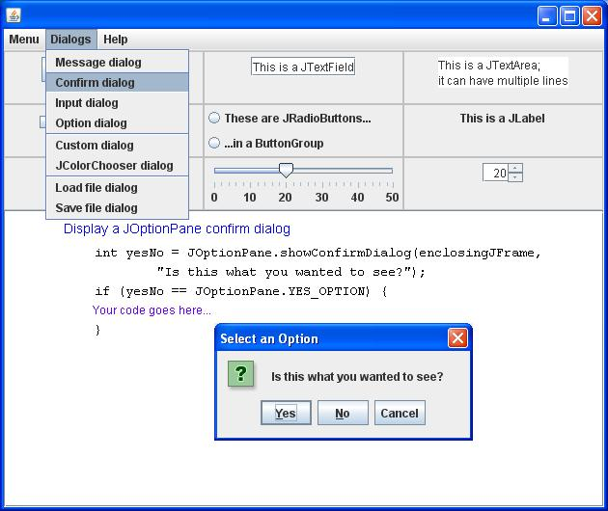
SwingExamples.jar

Slide 33
The End

